Slide 1
Heltec LoRa 32 Range Limits
Akula Satya Sai Siva Rama Krishna, Alva Sai Sindhu, Dasari Sumanth, Garikapati Lakshmi Gayathri Gatla Neha,
Goduguluri, Lakshmi Durga, Pannala Shashikumar

Slide 2
Introduction
The Heltec LoRa 32 is a versatile sensor board integrating LoRa communication for long-range wireless connectivity and various sensors for diverse IoT applications.

Slide 3
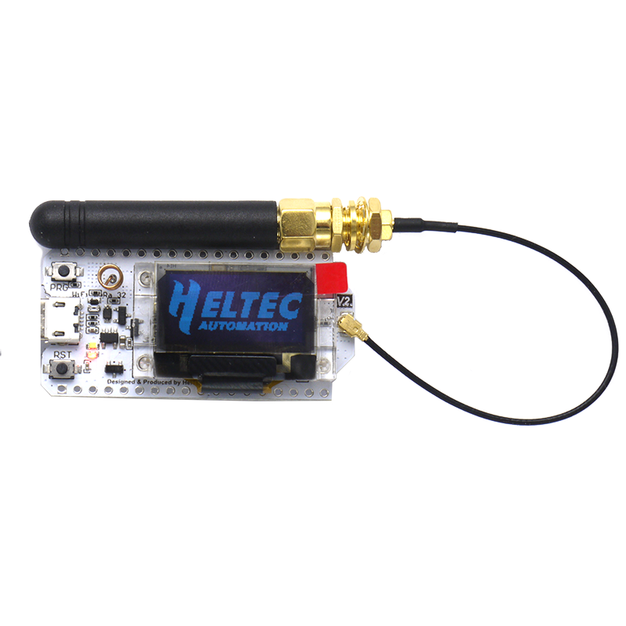
Hypothesis
What is the relationship between LoRa transmission range and environmental factors in varying terrains ?
Without obstacles
With obstacles
With metal ground

Slide 4
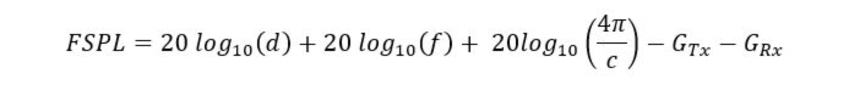
Parameters
Received Signal Strength Indicator (RSSI): Measured in dBm, indicates the strength of the received signal. A higher RSSI value represents a stronger signal.
Signal-to-Noise Ratio (SNR): Measured in dB, indicates the ratio of the signal power to the noise floor. A higher SNR value represents a better signal quality.

Slide 5
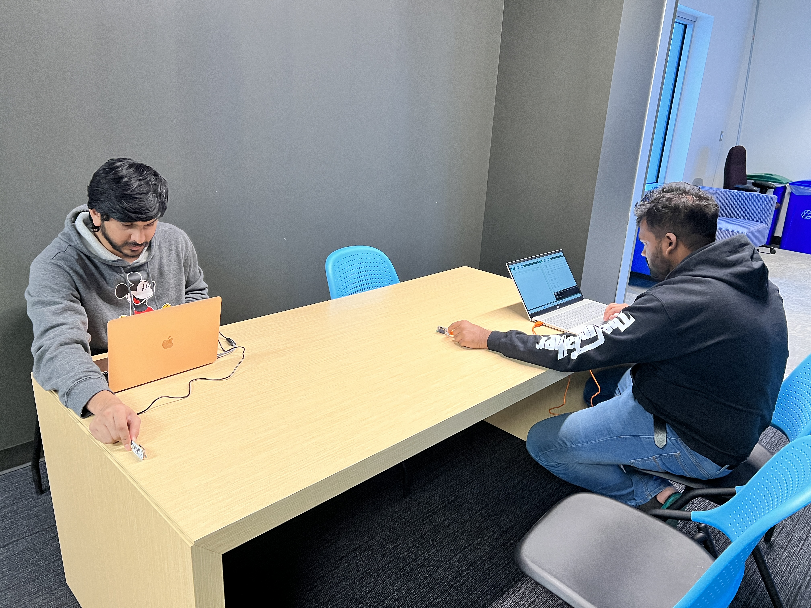
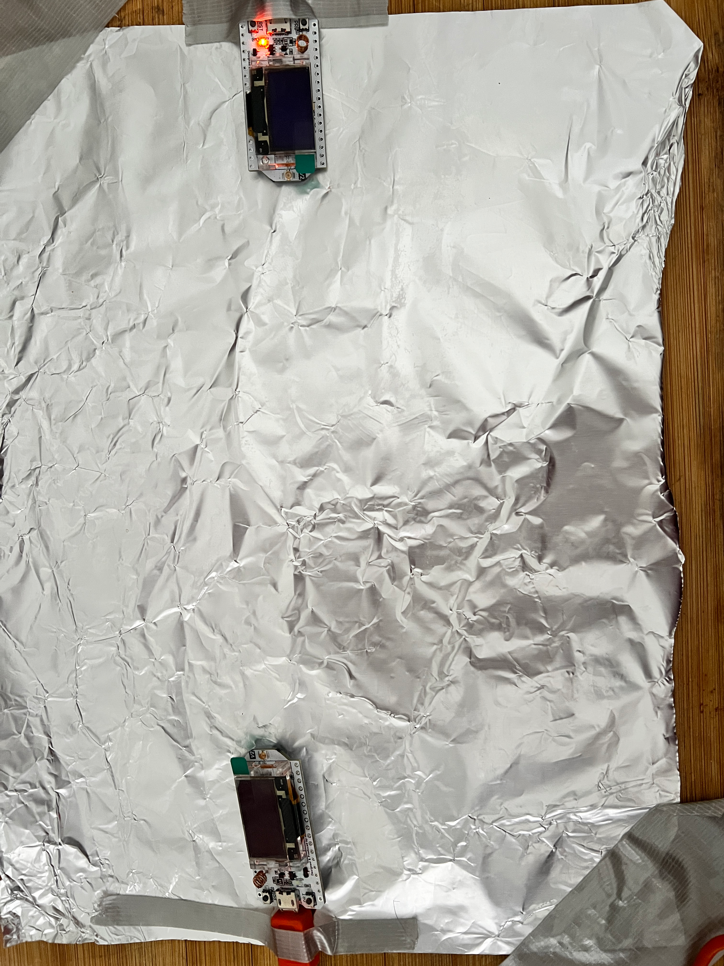
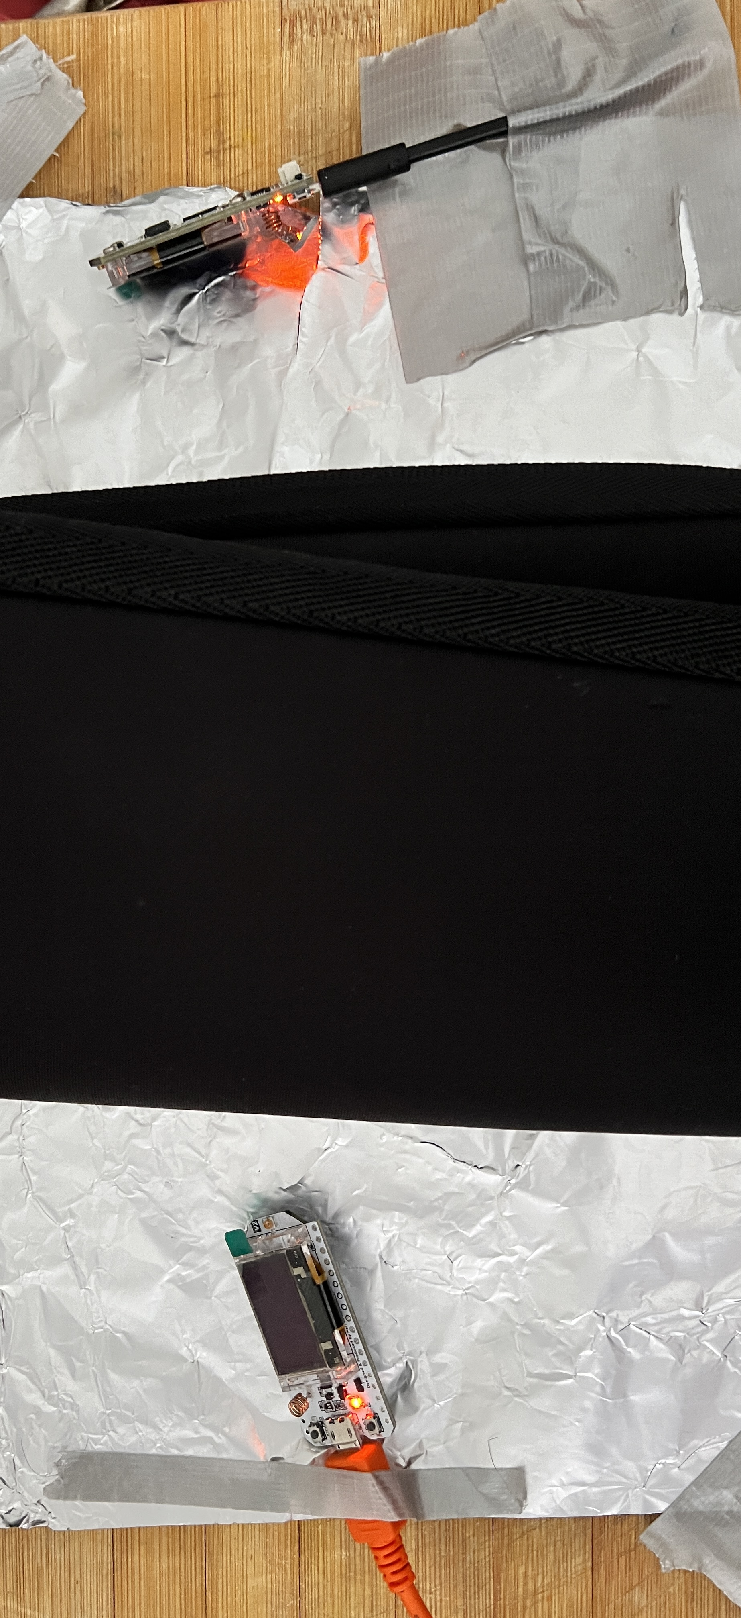
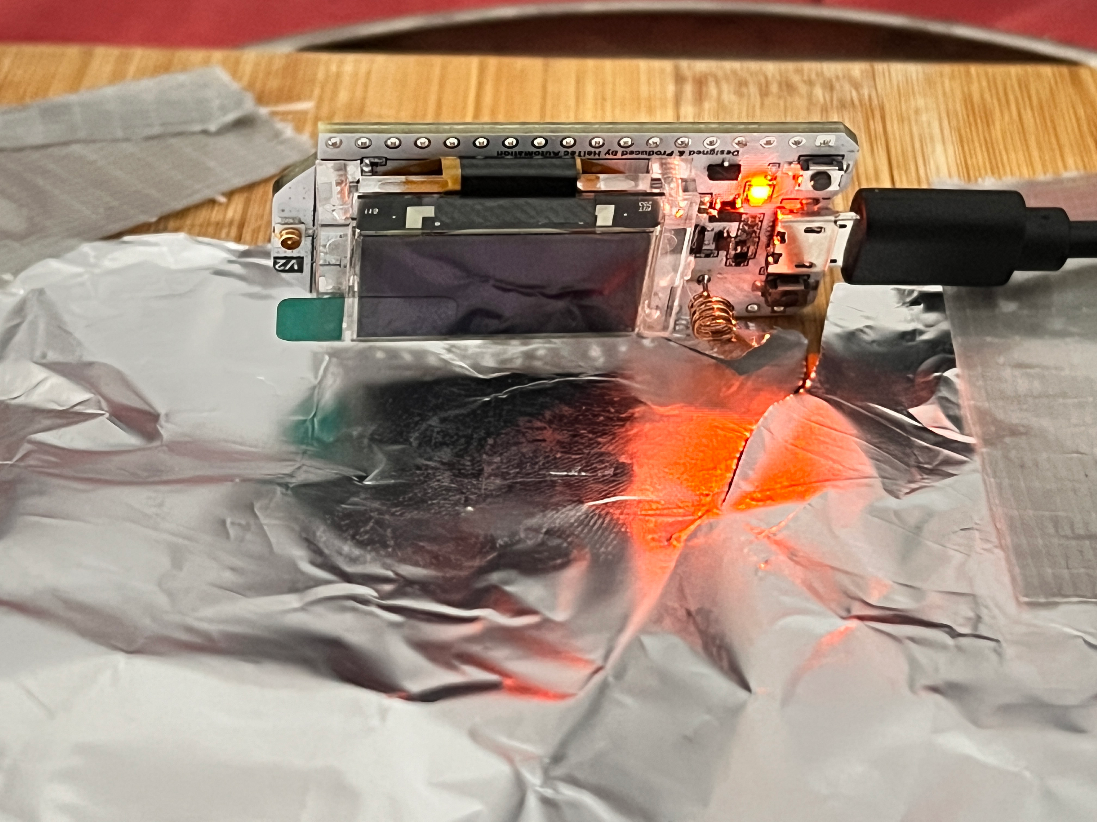
Set-up & Experimental Environment
Case :1
Case :2
Case :3
Case :4

Slide 6
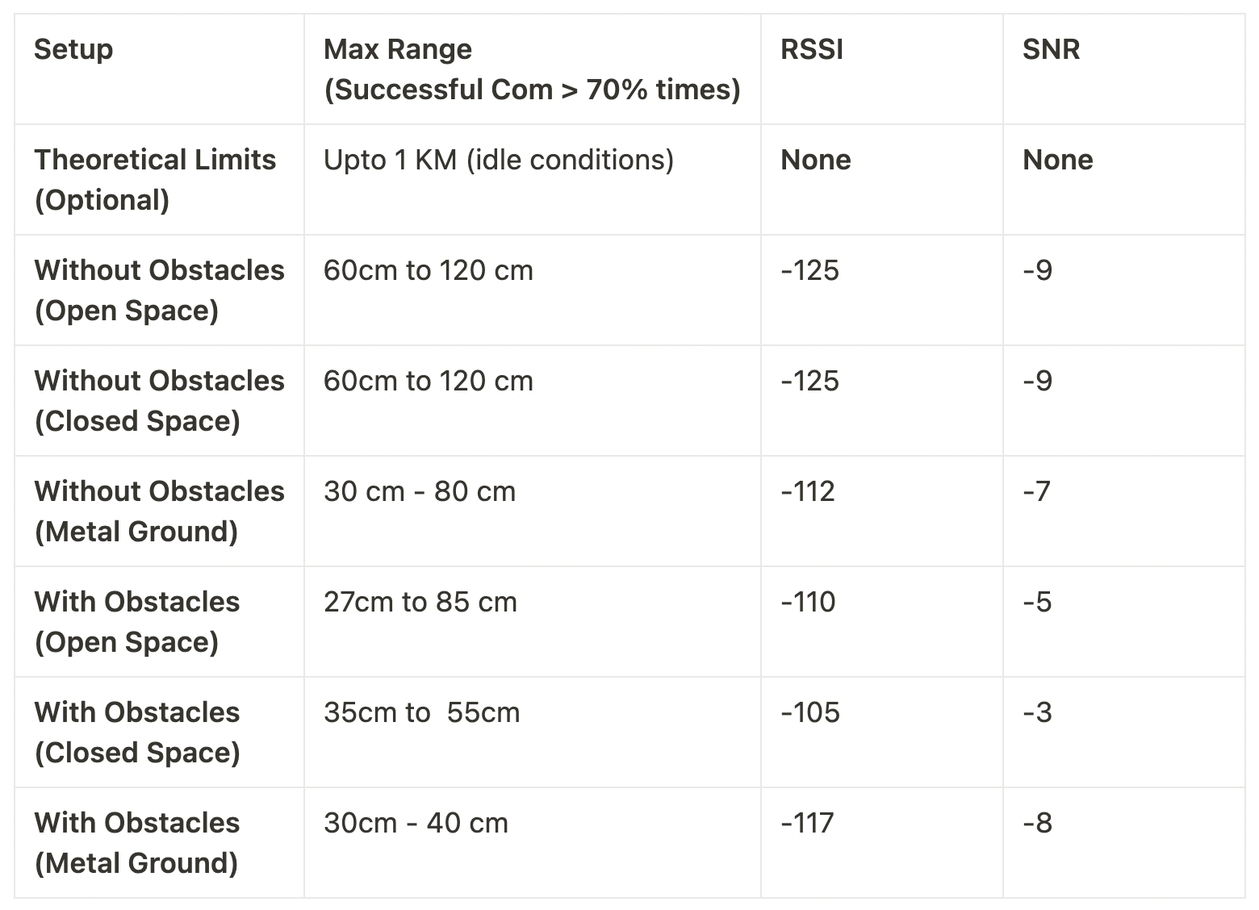
Results
The results showcase the correlation between LoRa transmission range and environmental variables, indicating the impact of terrain and conditions on signal strength
Note : LoRa Heltec Antenna would enable to communicate for higher ranges

Slide 7
Conclusion
The project conclusively highlights the significance of terrain and environmental factors in determining LoRa's transmission range, emphasizing the need for adaptive strategies in IoT deployments

Slide 8
Thank You

